Slide 1
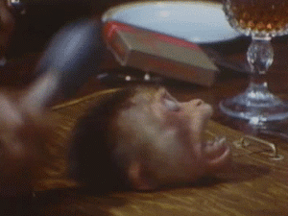
Hacking the Mind

Slide 2
Can the mind be hacked?
What is hacking?
Hacking is the modification of a tool to serve a different purpose than was originally intended.
The mind is a tool of logic and reason, therefore it can be hacked.

Slide 3
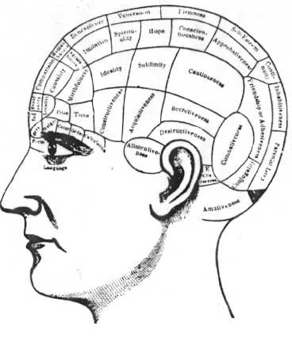
How do you hack the mind?
Hacking the mind refers to the psychological manipulation of a person's thought-pattern (purpose) and the physical alteration of brain chemistry using overt (violence/threat of violence) and covert (speech, colors, sound, pharmaceuticals) methods.

Slide 4
Overt Hacking
Violence/Threat of Violence
How does violence qualify as a hack?

Slide 5
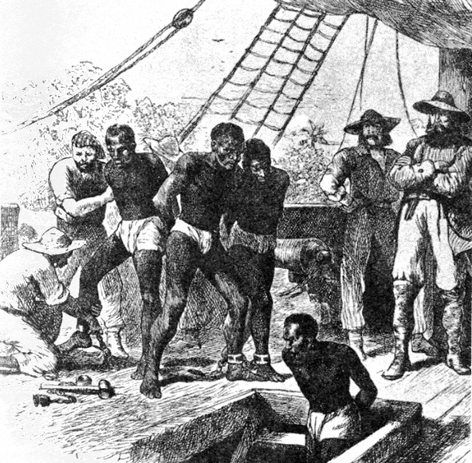
Slavery as a Hack
Man realized that an individual will produce more than he consumes in a lifetime. By tweaking the use of violence to manipulate entire human populations, he could exponentially improve his ability to obtain and secure resources.

Slide 6
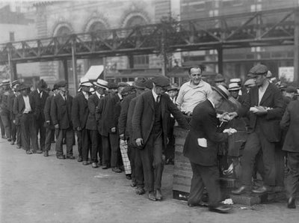
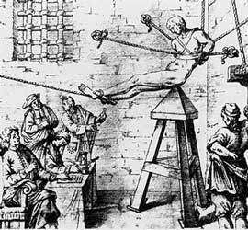
Slavery: A Process
Control Resources
Instill Fear
Restrict Movement
Conglomerate

Slide 7
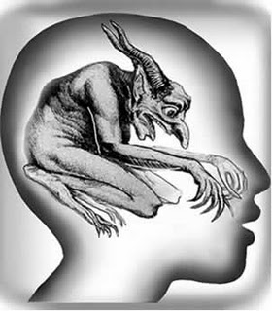
Covert Hacking
The Written/Spoken Word
Aside from physically enforcing a mental change, sometimes it is required to persuade using non-violent methods. One of the most important tools for hacking a person's reason is through speech, most importantly rhetoric and framing.

Slide 8
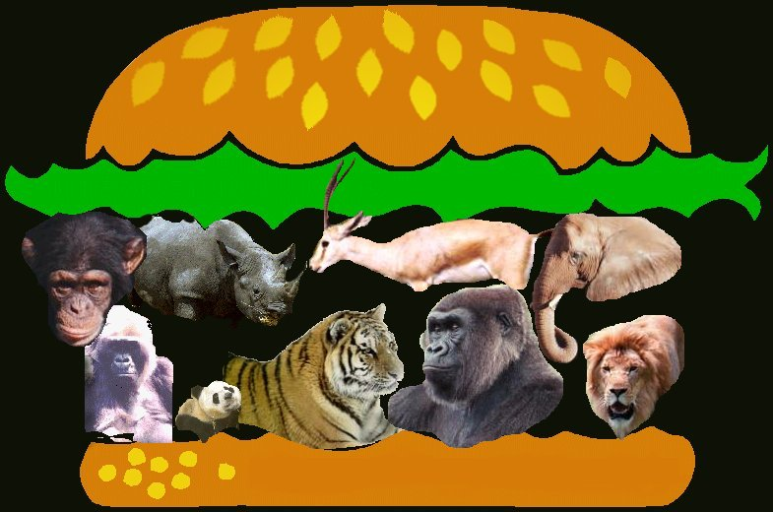
Rhetoric
"Animals don't have rights. They don't have rights, because people like me don't give them any. If a Bear in the woods feels like you violated its territory, tough shit, blow its head off. You have the "right" to be in a Bear's territory just as much as he does. I don't subscribe to that "he's just as afraid of you as you are of him" bullshit either. If the Bear was afraid of you, it would probably run away from you, rather than try to attack.. Unless the Bear is stupid, which he is."
-Maddox

Slide 9
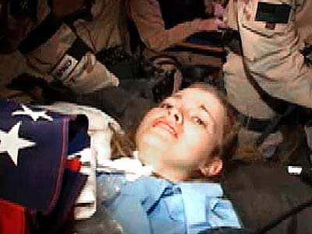
Framing
Jessica Lynch: An American Hero

Slide 10
Arguing fallacy
Ad Hominem: attack the person's character. Call him names, talk about her failed love life, mention his hatred for minorities, etc.
Appeal to authority: tell your reader, or listener, that someone famous agrees with you. Whether or not it is true doesn't matter. The goal is to impress the audience.
Statement of conversion: "I used to believe in ‘X’, but now that I am better educated, I reject 'X'".
Lying: Outright lying to the audience is the easiest, and sometimes most efficient, way to trick the reader to your side of the argument

Slide 11
Sound
http://www.youtube.com/watch?v=ldwLwlmFijM

Slide 12
Sound continued…
http://www.youtube.com/watch?v=JDXK1dFY_Pc

Slide 13
Sound continued…
http://www.youtube.com/watch?v=Jlelz3BPMAA&feature=related

Slide 14
COLORS
One of the main stimuli for our brains is sight. Therefore, colors play an important role in the subconscious hacking of the mind.
Black suggests power, boldness, and authority.
Blue suggests security, authority, faithfulness and dignity.
Brown suggests richness, politeness, helpfulness and effectiveness.
Gray suggests authority, practicality, earnestness and creativity.
Green suggests health, fertility, freedom, freshness, healing, tranquility and greed.
Orange suggests pleasure, cool, excitement, cheer, endurance, strength and ambition.
Pink suggests femininity, gentleness, well being and innocence.
Purple suggests spirituality, royalty, luxury, wealth, sophistication, authority and mournfulness. It is also feminine and romantic.
Red suggests excitement, strength, sex, passion, vitality, and aggressiveness. It stimulates a faster heartbeat and breathing.
White suggests refined, purity, devotion, contemporary and truthfulness. Doctors and nurses wear white to imply sterility.
Yellow suggests warmth, sunshine, cheer, happiness, jealousy deceit and cowardice.

Slide 15
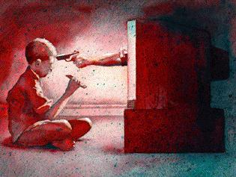
Colors/Sound/Rhetoric/Framing
Notice in these three advertisements the use of the four powerful covert mind hacking tools. Also take note that not all mind hacking is malicious. Mind hacking can be used to "debug" as well as harm.

Slide 16
Sexy Food
http://www.youtube.com/watch?v=X8nJKa13sBo

Slide 17
New World Order
http://www.youtube.com/watch?v=dMlqV8y5fnQ

Slide 18
An Experiment
Remove your cell-phones from your pockets and place on desk.

Slide 19
Suggestion/Subliminal
By merely suggesting outcomes or opinions, entire audiences can be swayed into believing anything.

